Slide 1
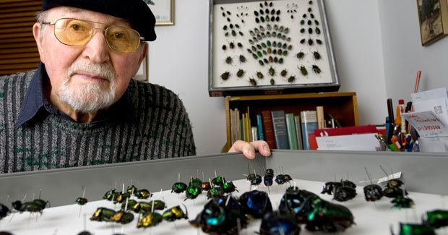
George F. Bornemissza – Dung Beetle Guru
The importation of dung beetles into Australia was the brainchild of George Bornemissza, a Hungarian born entomologist who worked for CSIRO from 1955 to 1983. His observation that fly problems in Australia were largely due to the lack of dung beetles adapted to imported livestock led CSIRO to import dung beetles from Africa and Europe from 1965-1985. The introduced beetles had a profound impact on fly populations, and the success of the project largely led to Dr Bornemissza being awarded the Medal of the Order of Australia in 2001. George recognised that there were still gaps to be filled with dung beetles when the project ended, which ultimately led to the Dung Beetle Ecosystem Engineers project. Dr Bornemissza, we salute you!
George F. Bornemissza
Lessons from the homeland
While visiting livestock paddocks in Western Australia, George noticed that cattle dung often littered the landscape. This was quite different to the farm landscape in his native Hungary, where various species of dung beetle carried off dung and buried it, resulting in less fouling of paddocks and fewer fly pests. He reasoned that importing dung beetles adapted to cattle dung might solve both problems; the native species of dung beetle simply couldn’t handle this type of dung because they were adapted to dry pelleted dung characteristically produced by native marsupial fauna in Australia. He lobbied doggedly to introduce foreign dung beetles to Australia, finally gaining funding from the Australian Meat Research Committee in 1965.
Who was George Bornemissza?
George Bornemissza was born in 1924 in Hungary. He showed an aptitude for entomology at an early age, collecting and studying beetles in the forests near his home town as a teenager. He spent much of his spare time volunteering in museums and scientific institutions in Budapest.
George obtained a PhD in zoology at the University of Innsbruck (Austria) in 1950 and fled central Europe in the face of Soviet takeover and arrived in Western Australia at the end of 1950. He worked with the Department of Zoology at the University of Western Australia for three years before taking a job with CSIRO in 1955.
The Australian Dung Beetle Project
The Australian Dung Beetle Project was active from 1965 through 1985. During that time, George identified nearly 150 species of dung beetle from other countries with potential to fill open niches were livestock dung was not being recycled by native species. He spent nine years in Africa, which has an extensive fauna of large mammalian herbivores. During the twenty years of the project, CSIRO introduced 50 species of dung beetles to Australia, 23 of which have become established. The extent to which these species have spread and the gaps still left unfilled by dung beetles are not fully known, leading to some of the objectives of the DBEE project
A Fitting Recognition
For his services to science and entomology, and the improvement of the lives of Australians as a result of the Australian Dung Beetle Project, Geoge was awarded a Medal of the Order of Australia in the General Division. His legacy lives on in the names of twenty species of insects named in his honour. We recognise George Bornemissza with a plaque beside the mass rearing facility of the DBEE project.

