Slide 1
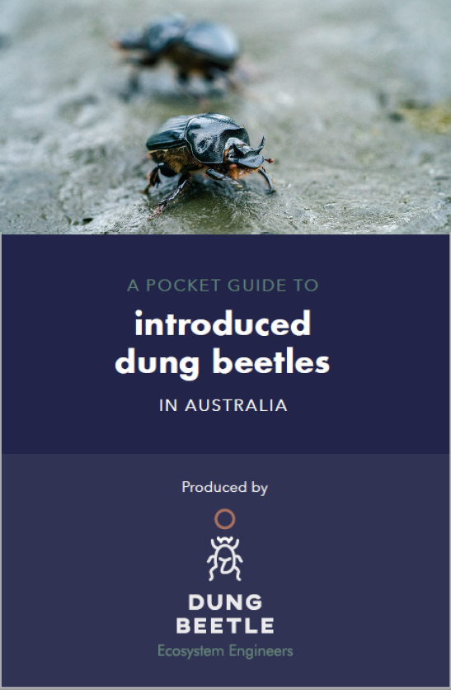
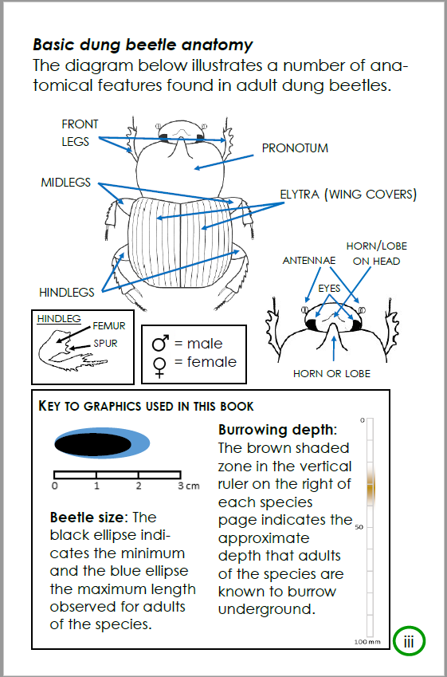
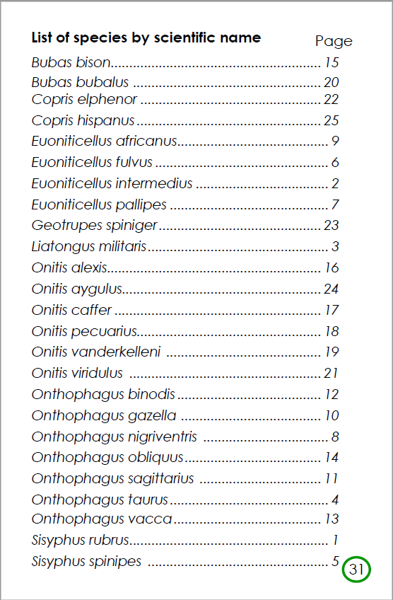
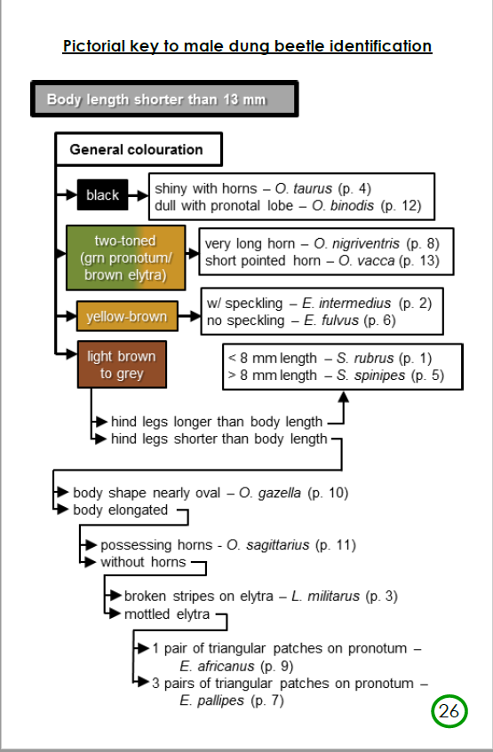
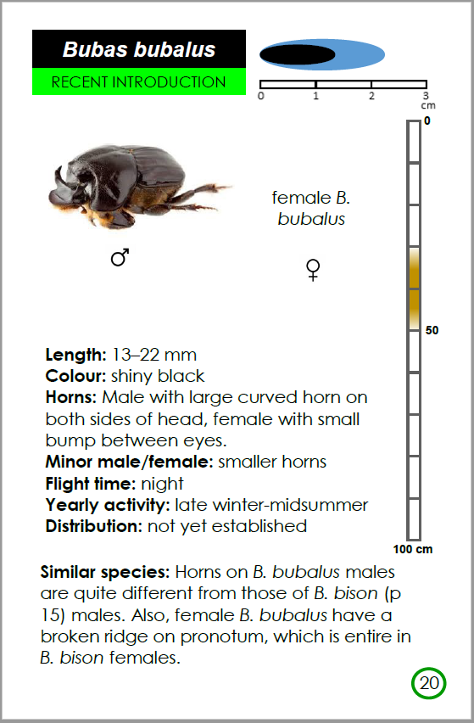
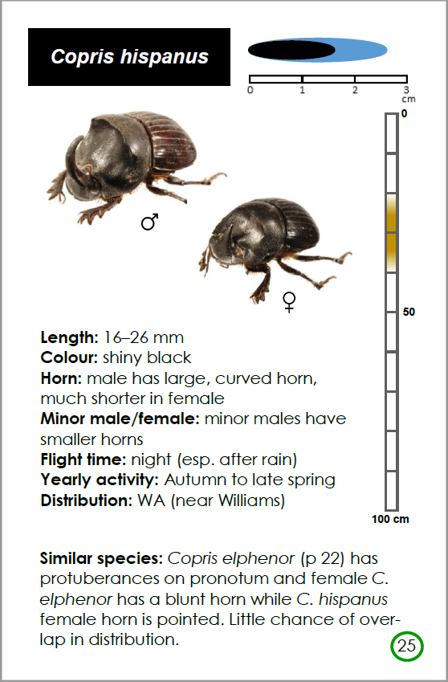
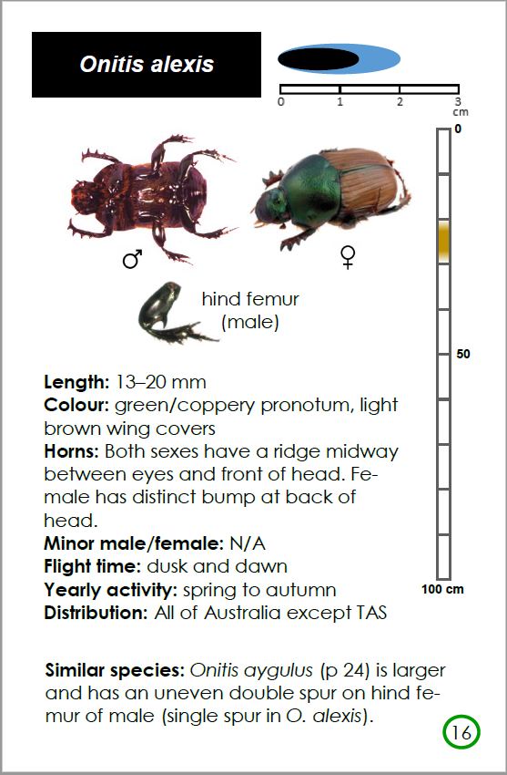
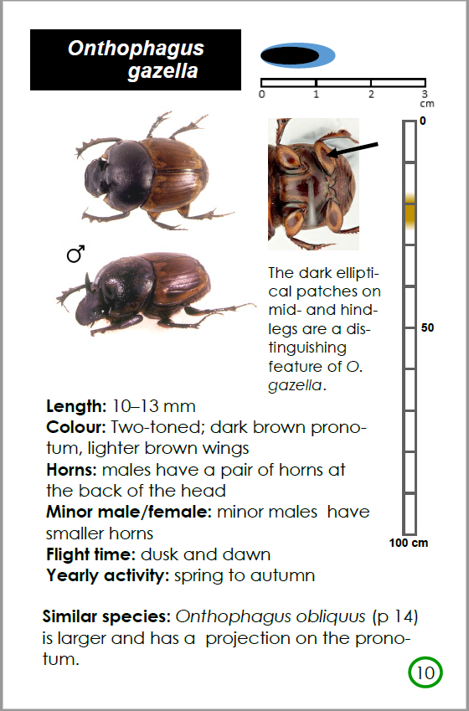
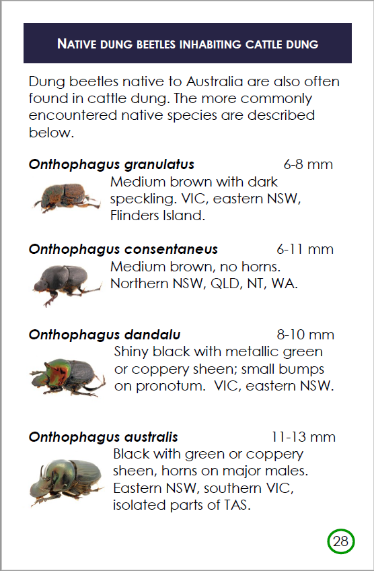
A Pocket Guide to Introduced Dung Beetles In Australia will be a useful field guide for identifying any of the introduced species of dung beetle in Australia and New Zealand. The book is printed on durable plastic-coated paper and bound with a spiral binding, making it easy to fit in your pocket. The species are arranged in size order, making it easier to find a possible match to a beetle in hand.
A pictorial key will further assist the user in working out the identity of specimens. Several common native species sometimes found in livestock dung are also included in the guide. Below are some representative pages from the book.

